Slide 1
DE PROJECT VIRTUAL HOSPITAL
</
/>
8/10/2024

Slide 2
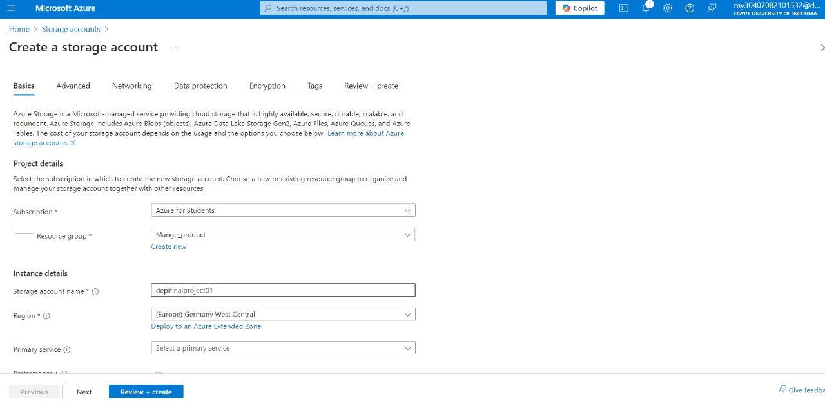
Azure storage creation

Slide 3
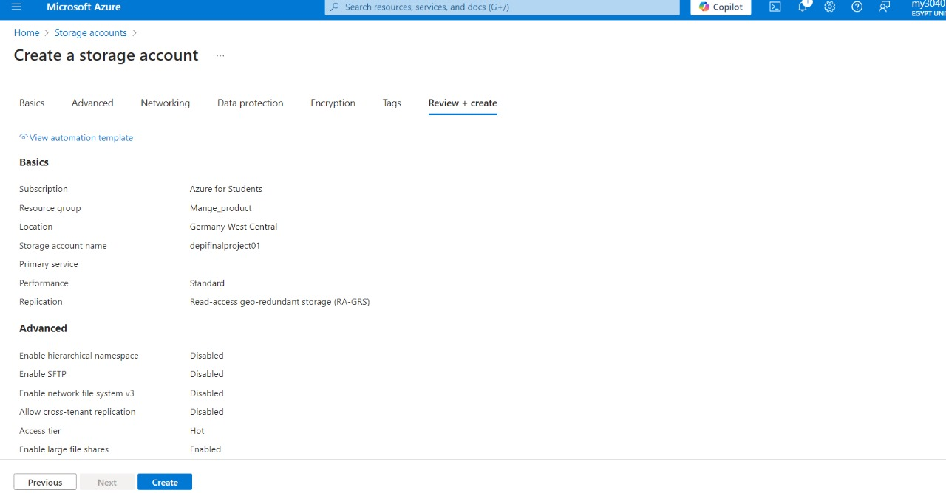
Azure storage creation

Slide 4
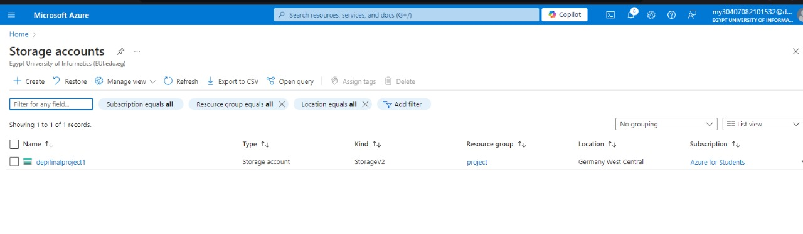
Azure storage creation

Slide 5
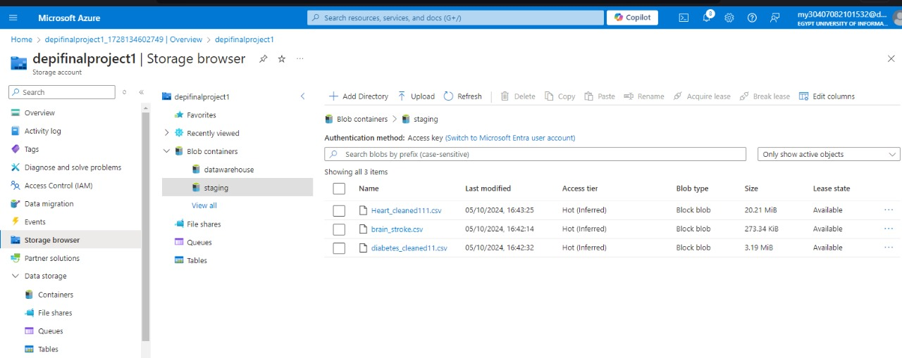
Azure storage creation

Slide 6
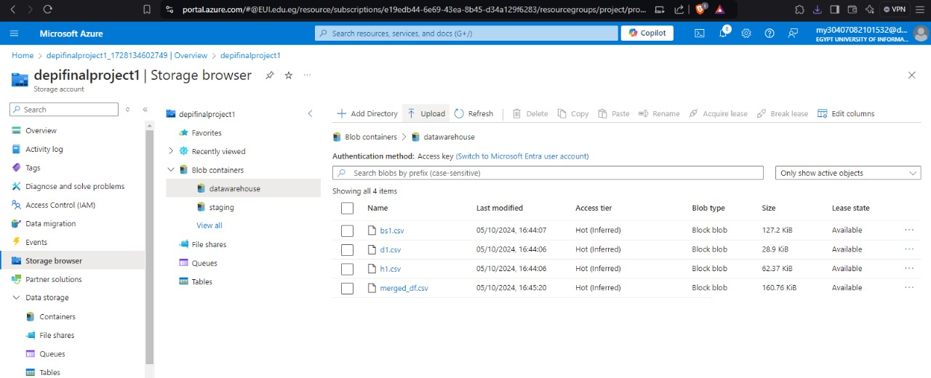
Azure storage creation

Slide 7
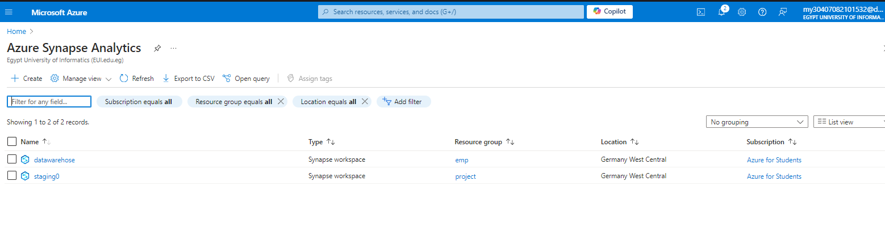
Azure Synapse workspace initialization

Slide 8
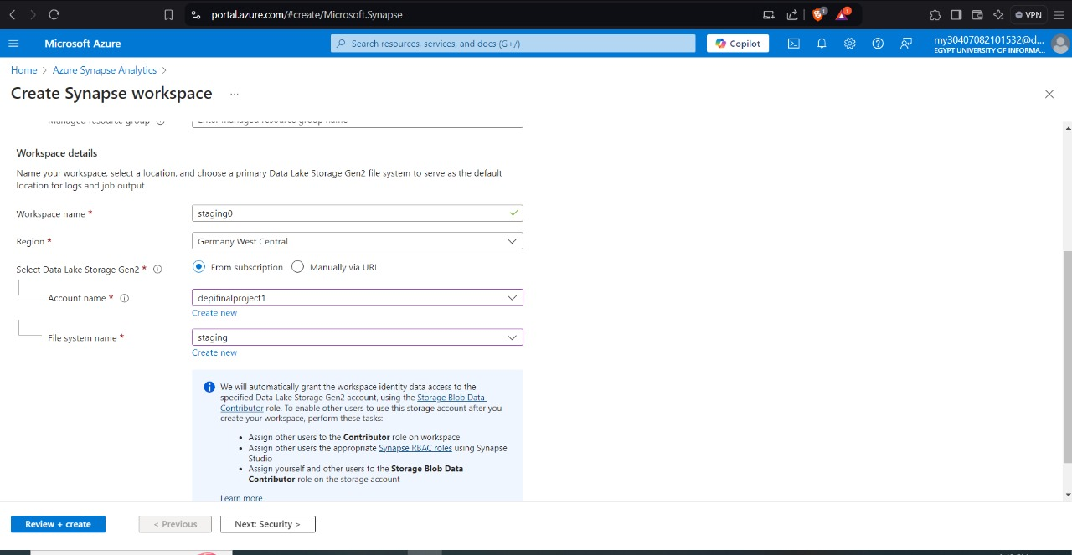
Azure Synapse workspace initialization

Slide 9
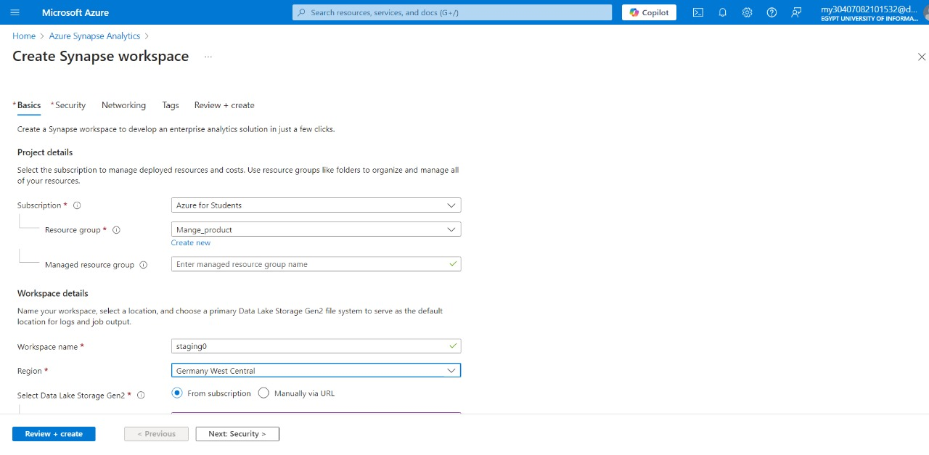
Azure Synapse workspace initialization

Slide 10
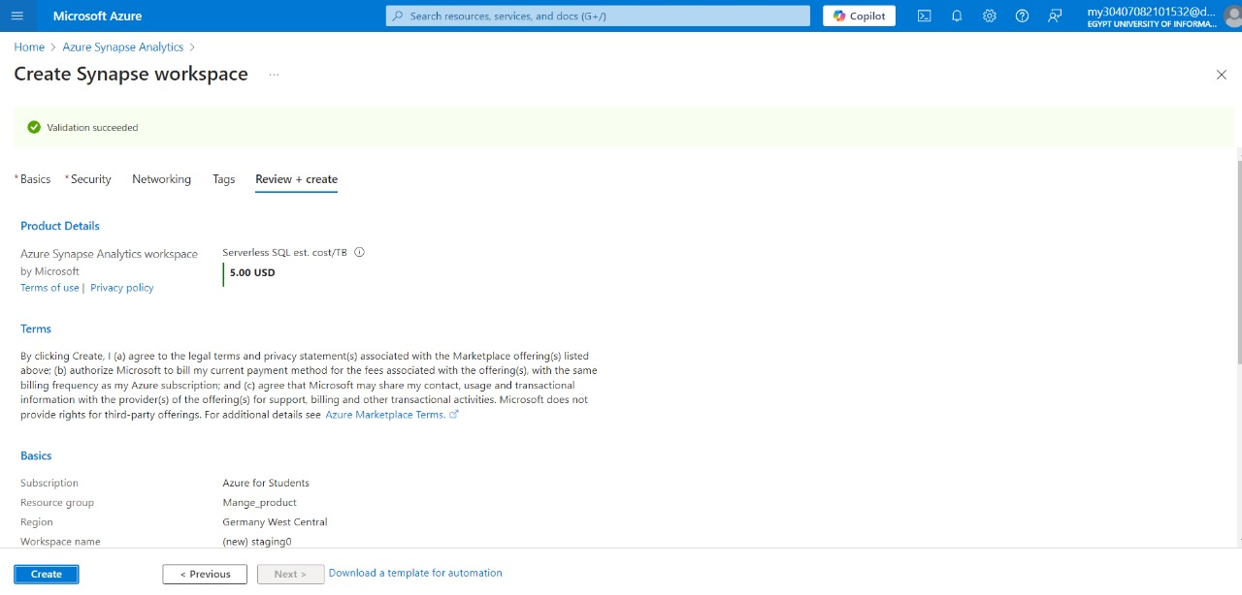
Azure Synapse workspace initialization

Slide 11
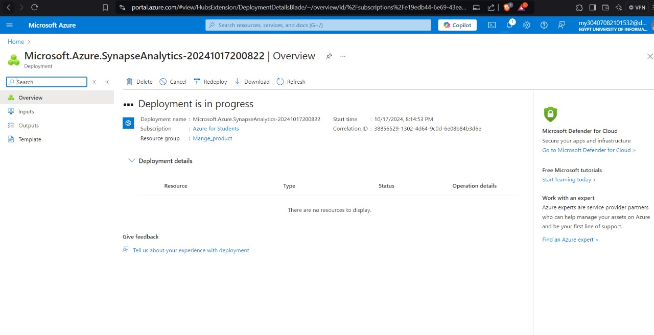
Azure Synapse workspace initialization

Slide 12
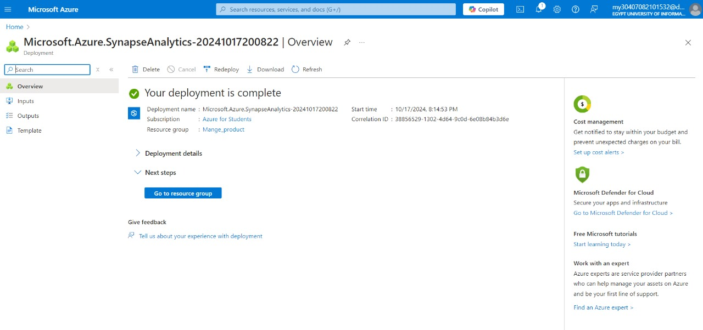
Azure Synapse workspace initialization

Slide 13
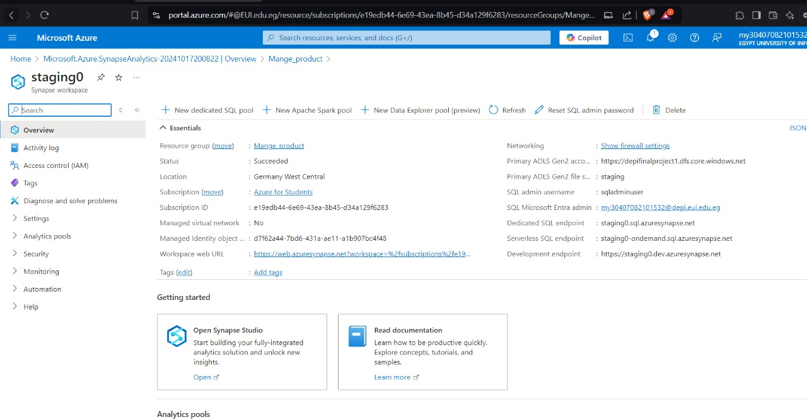
Azure Synapse workspace initialization

Slide 14
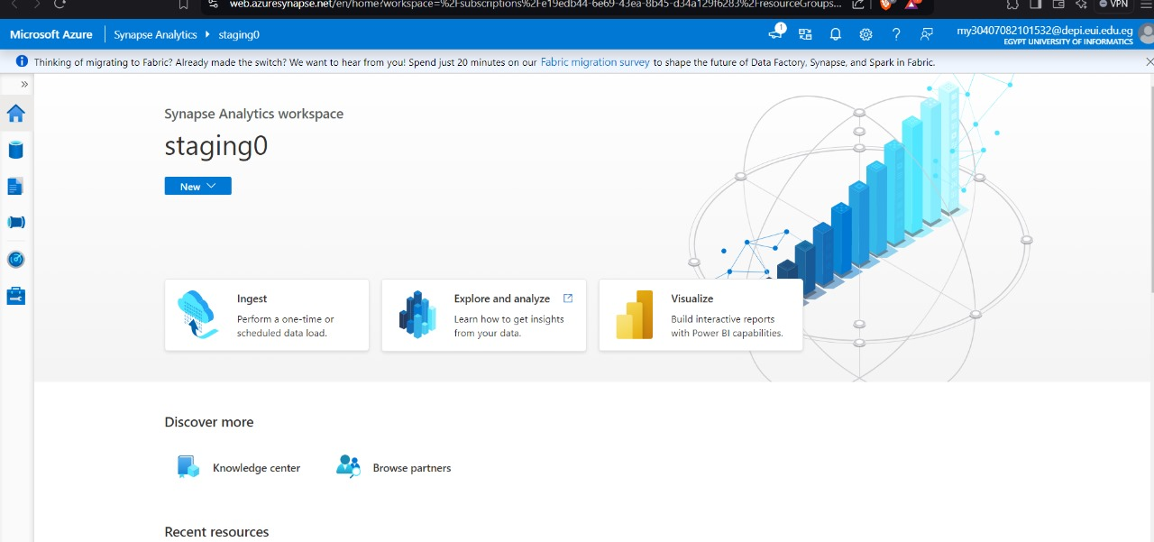
Azure Synapse workspace initialization

Slide 15
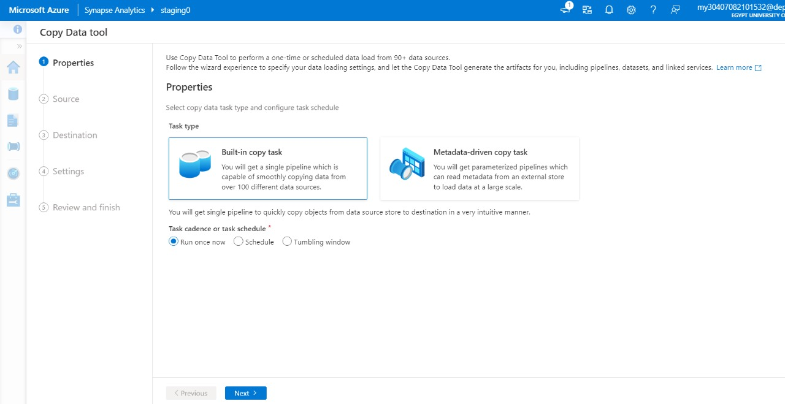
Azure Synapse workspace initialization

Slide 16
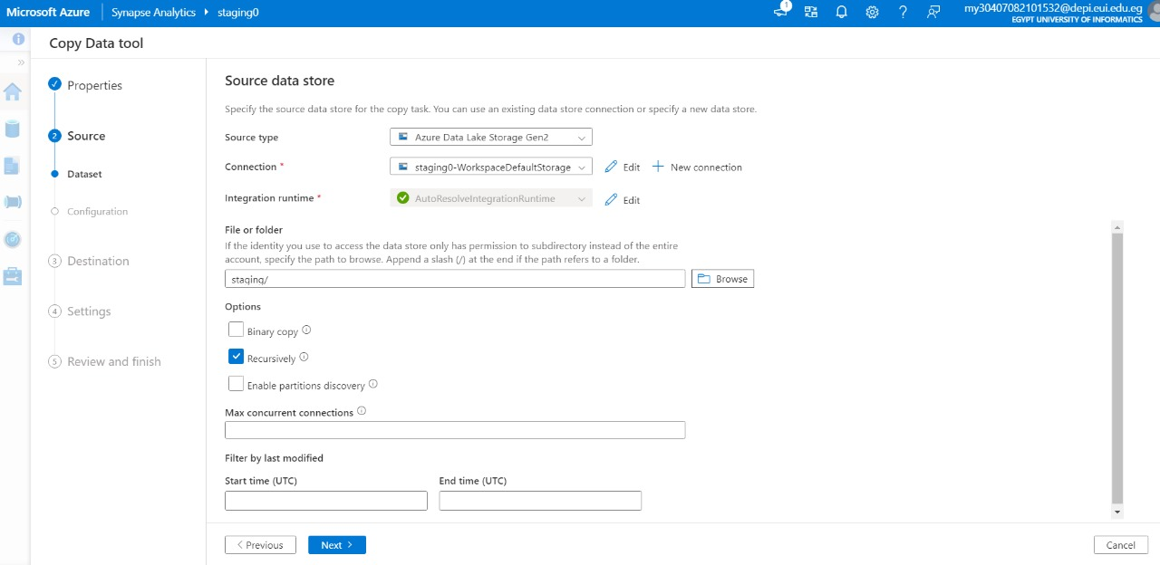
Azure Synapse workspace initialization

Slide 17
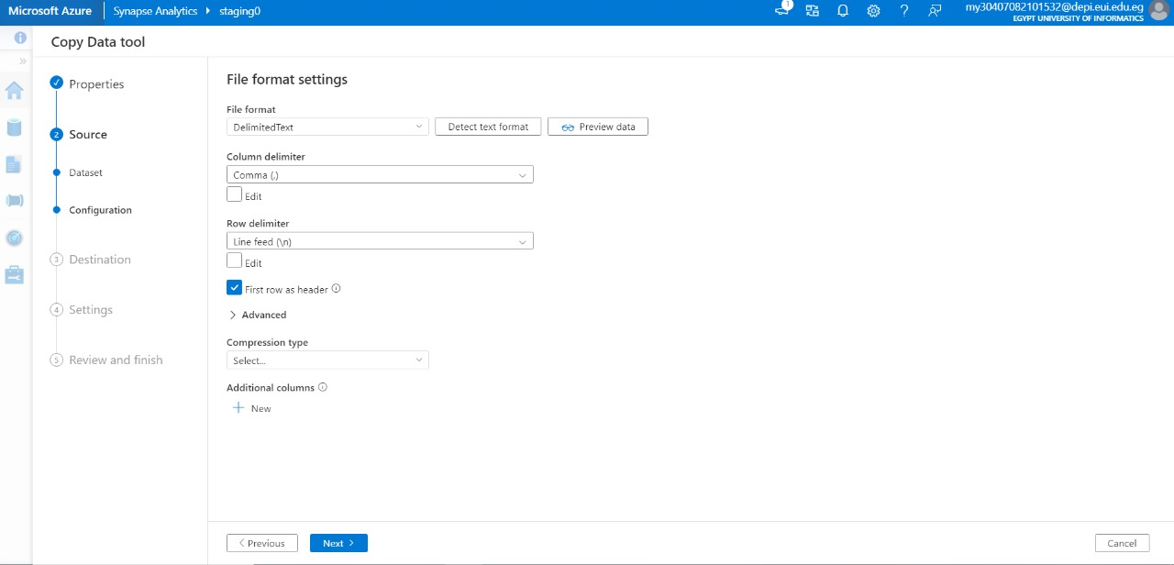
Azure Synapse workspace initialization

Slide 18
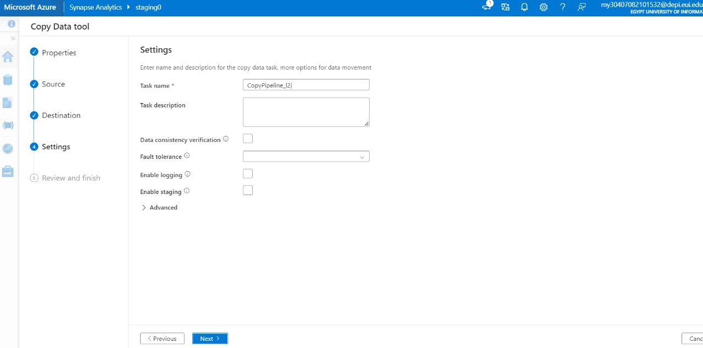
Azure Synapse workspace initialization

Slide 19
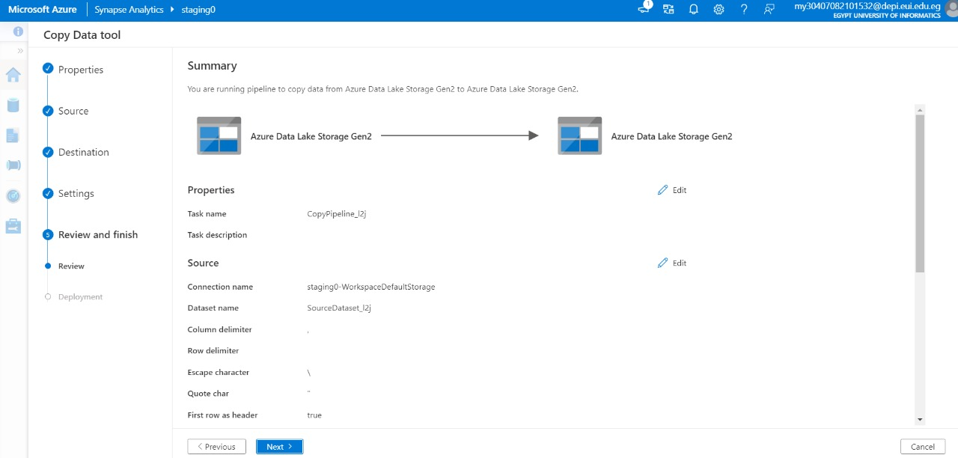
Azure Synapse workspace initialization

Slide 20
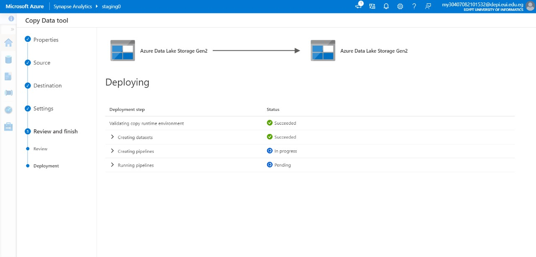
Azure Synapse workspace initialization

Slide 21
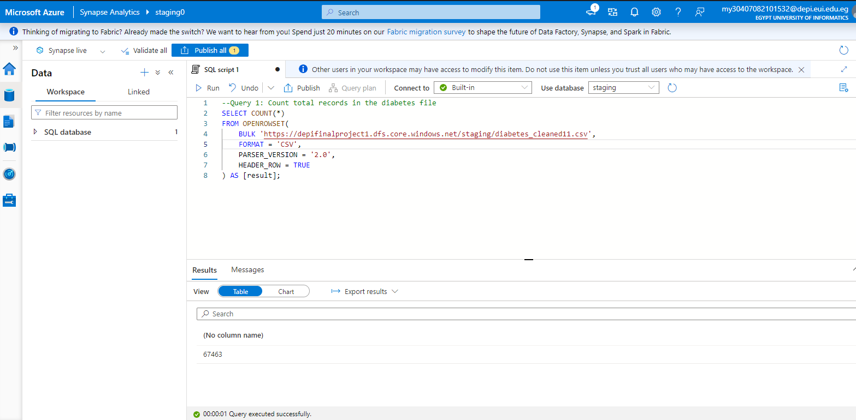
Queries on staging tables
This SQL query is using the COUNT() function to count the number of rows in a table

Slide 22
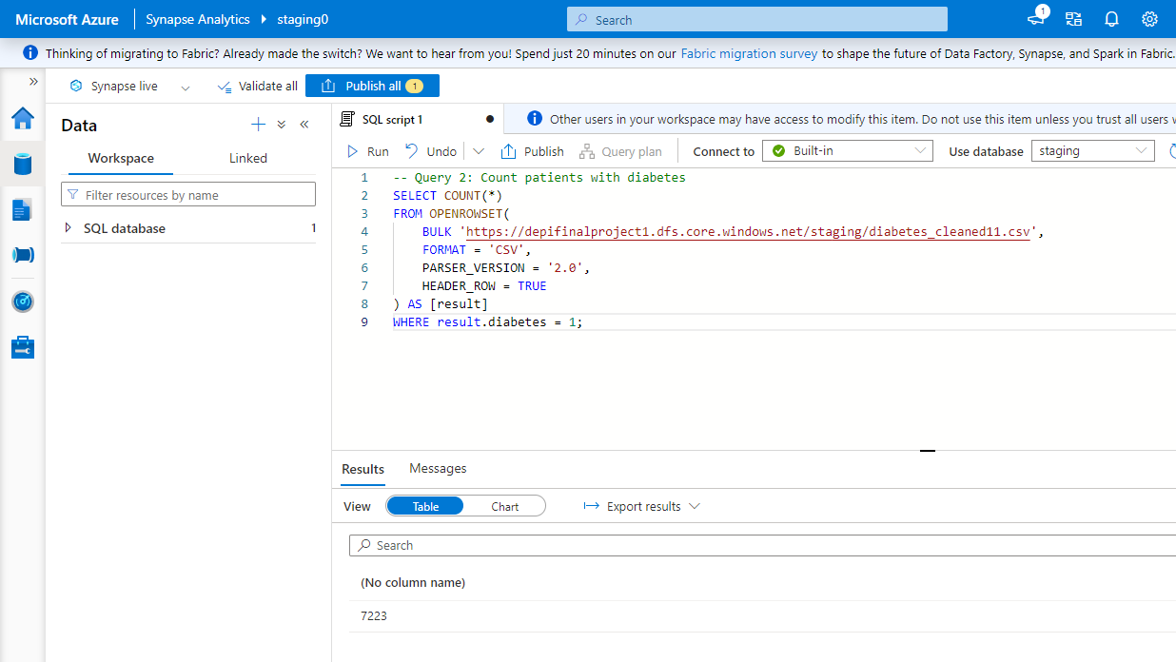
Queries on staging tables
This SQL query counts the number of patients with diabetes. It uses where clause to extract the 'diabetes' field from each row, filtering for values equal to 1 (indicating diabetes).

Slide 23
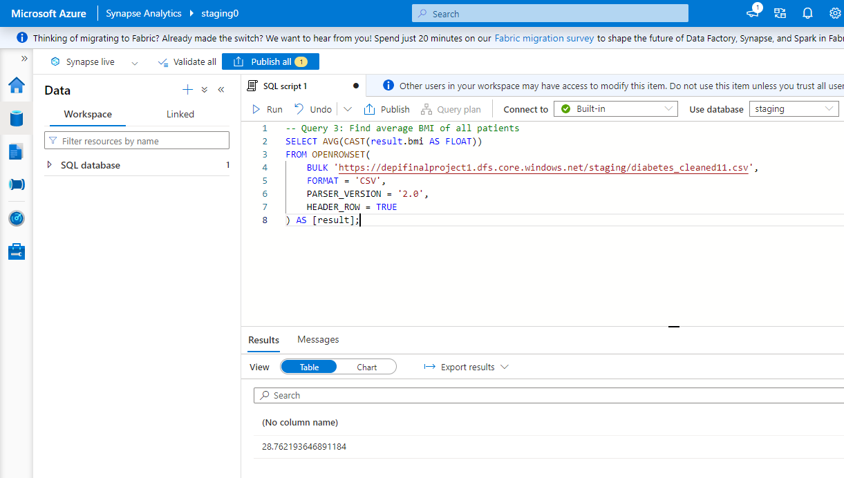
Queries on staging tables
This SQL query calculates the average BMI of all patients in the dataset. The AVG function computes the mean of these BMI values, and the result is cast to FLOAT for precision

Slide 24
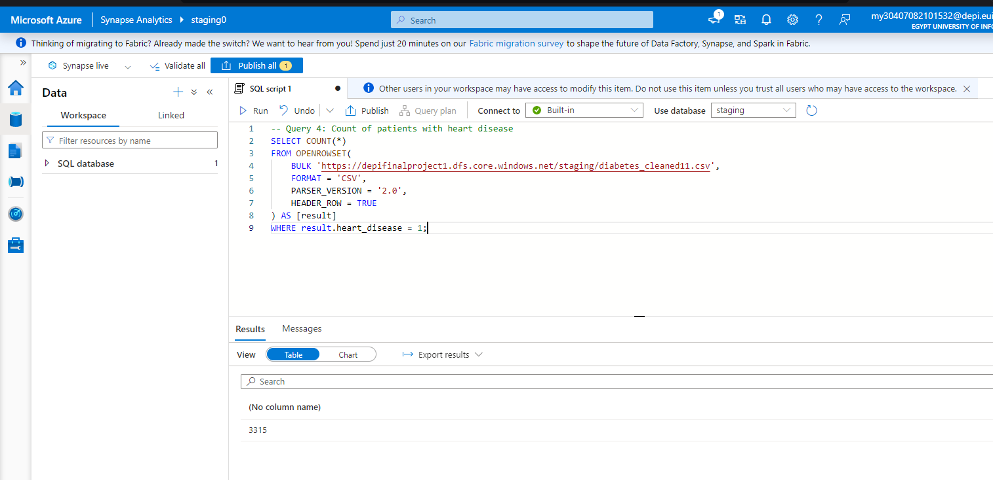
Queries on staging tables
This SQL query counts the number of patients with heart disease in the dataset. The COUNT function tallies the rows where 'heart_disease' equals 1, indicating the presence of heart disease

Slide 25
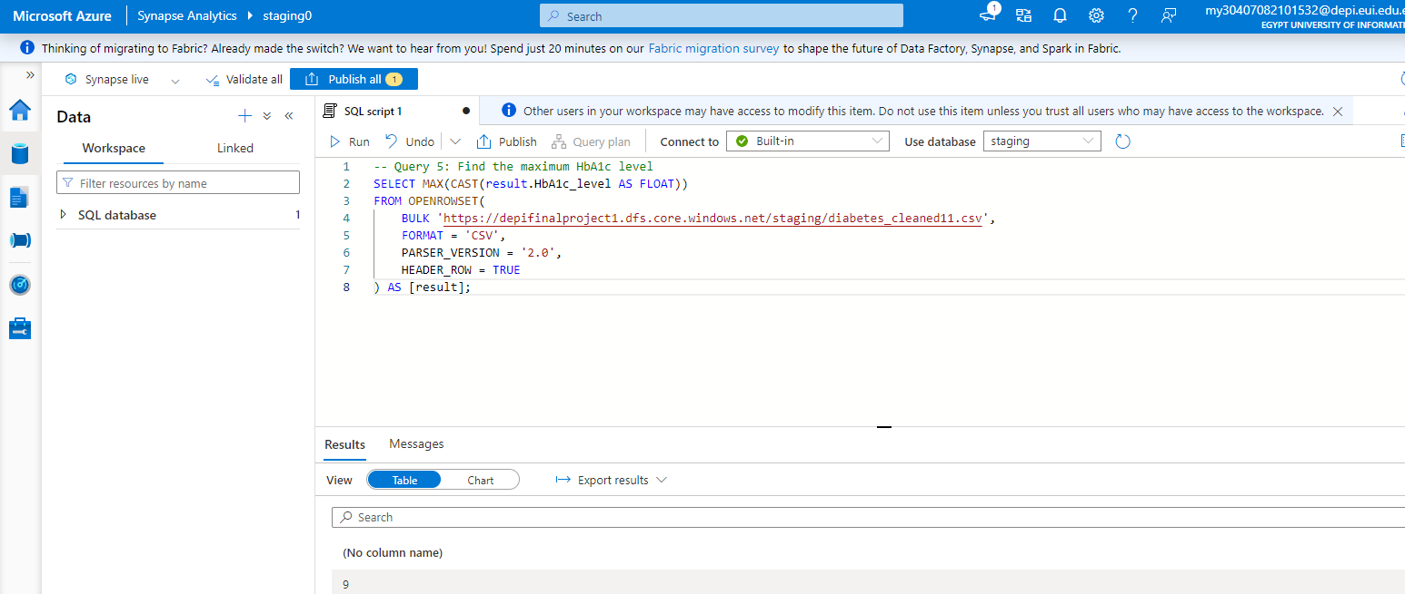
Queries on staging tables
This query extracts all the HbA1c fields from the date set and returns the highest value

Slide 26
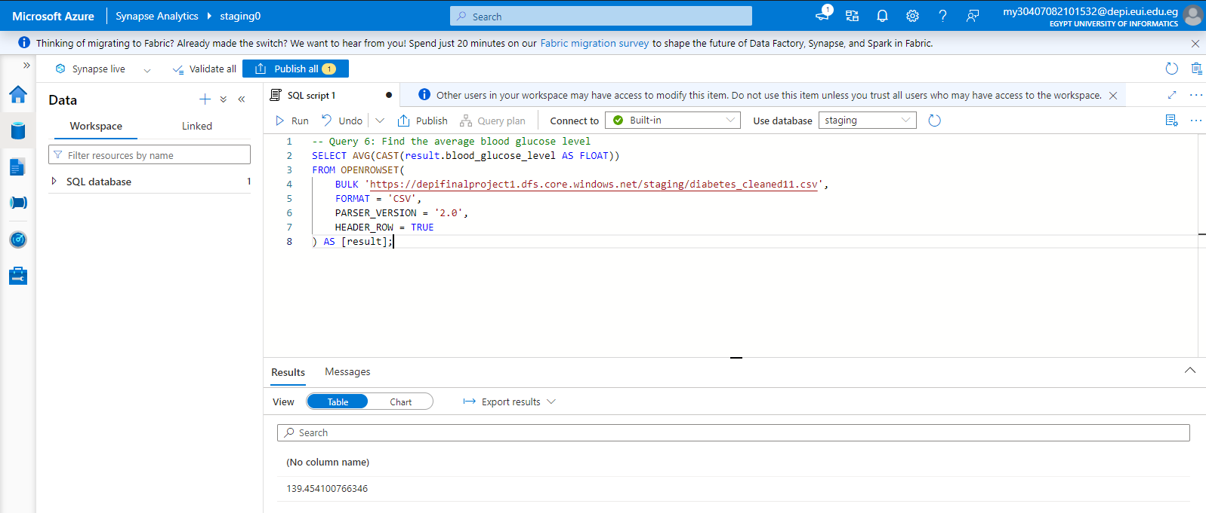
Queries on staging tables
This query extracts all the blood glucose level fields from the date set and returns the average value

Slide 27
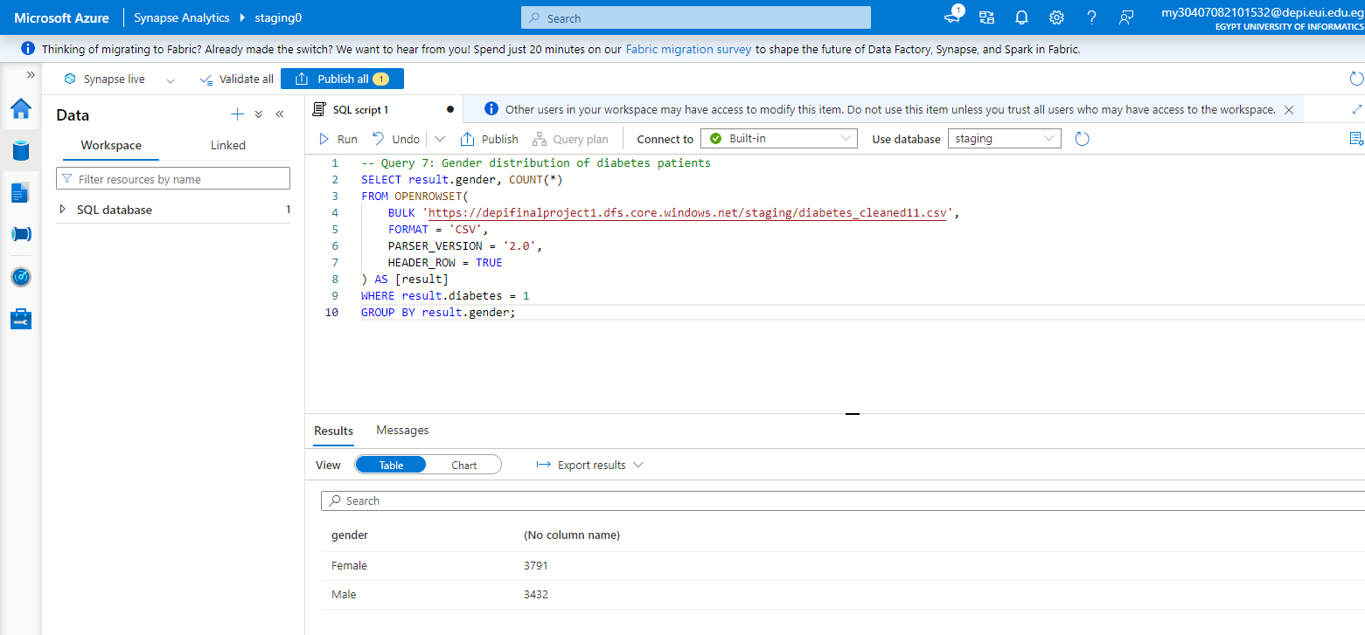
Queries on staging tables
This query extracts all the gender fields from the date set and groups by gender and counts the number of rows associated with each value for gender

Slide 28
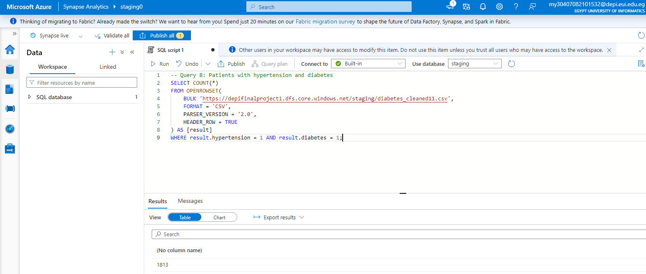
Queries on staging tables
This query extracts all the hypertension and diabetes fields from the dataset and returns count of rows where both columns equals 1

Slide 29
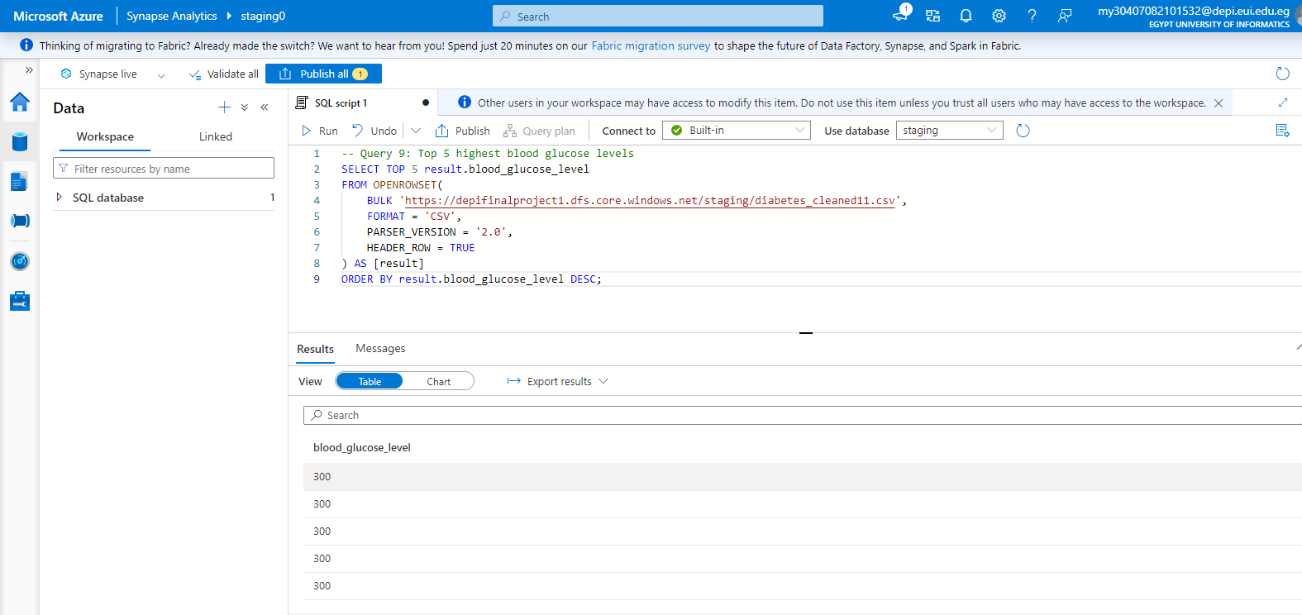
Queries on staging tables
This query extracts top 5 blood_glucose values and then shows the whole row.

Slide 30
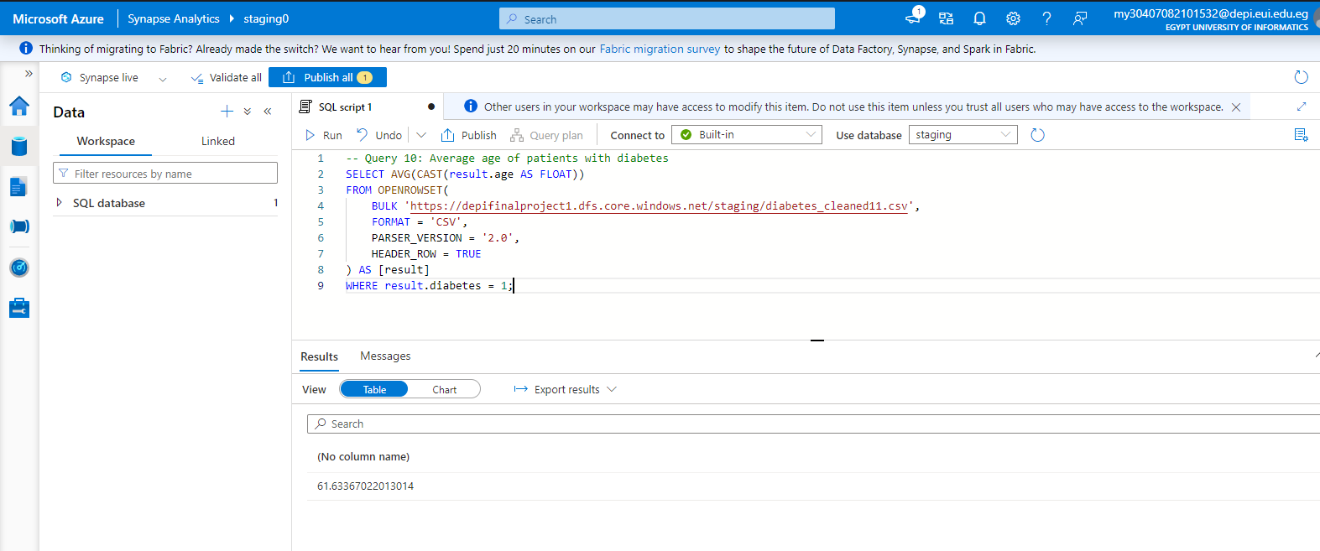
Queries on staging tables
This SQL query calculates the average age of patients with diabetes in the dataset. It uses OPENROWSET to access the data and extract the 'age' and 'diabetes' fields from each row. The AVG function computes the mean age, but only for rows where the 'diabetes' value equals 1 (indicating diabetic patients).

Slide 31
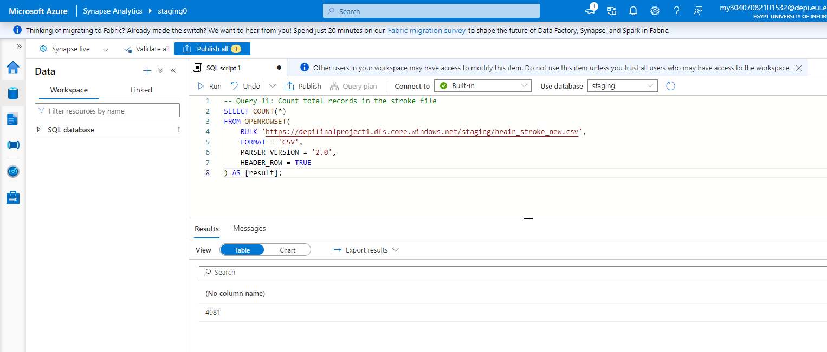
Queries on staging tables
This SQL query calculates the number of patients in the dataset. The count function accesses each row and returns a int.

Slide 32
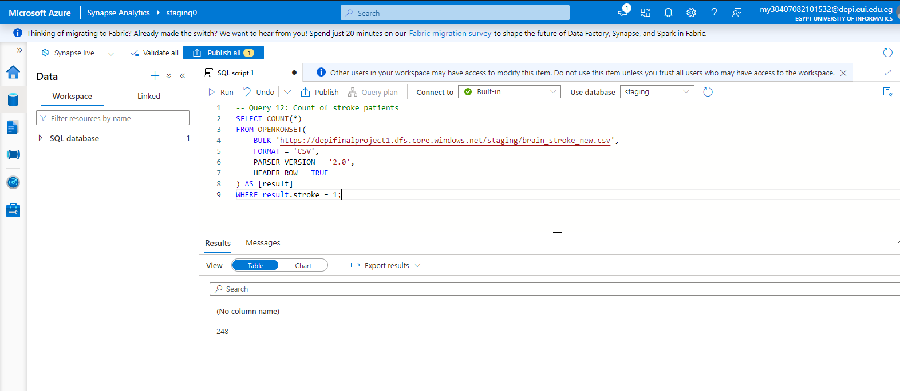
Queries on staging tables
This SQL query counts the number of smokers in the dataset. It uses OPENROWSET to access the data source, and extract the 'smoking' field from each row. The COUNT function then tallies the rows where the 'smoking' value equals 1, which presumably indicates a smoker.

Slide 33
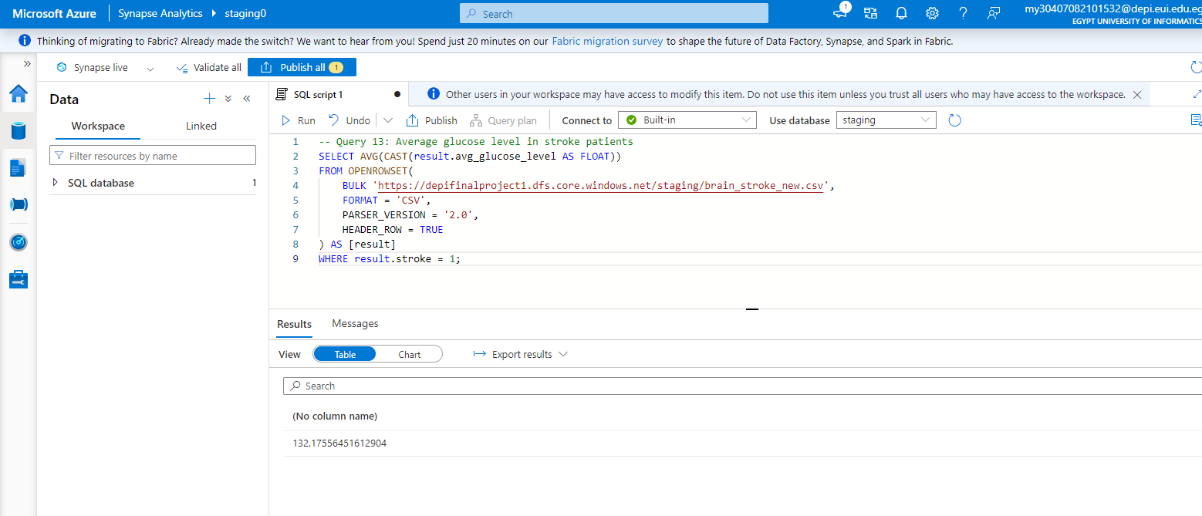
Queries on staging tables
This SQL query calculates the average glucose level for patients in the dataset. It uses OPENROWSET to access the data and extract the 'glucose' and 'sex' fields from each row. The AVG function computes the mean glucose level, but only for rows where the 'sex' value equals 'F' (indicating female patients).

Slide 34
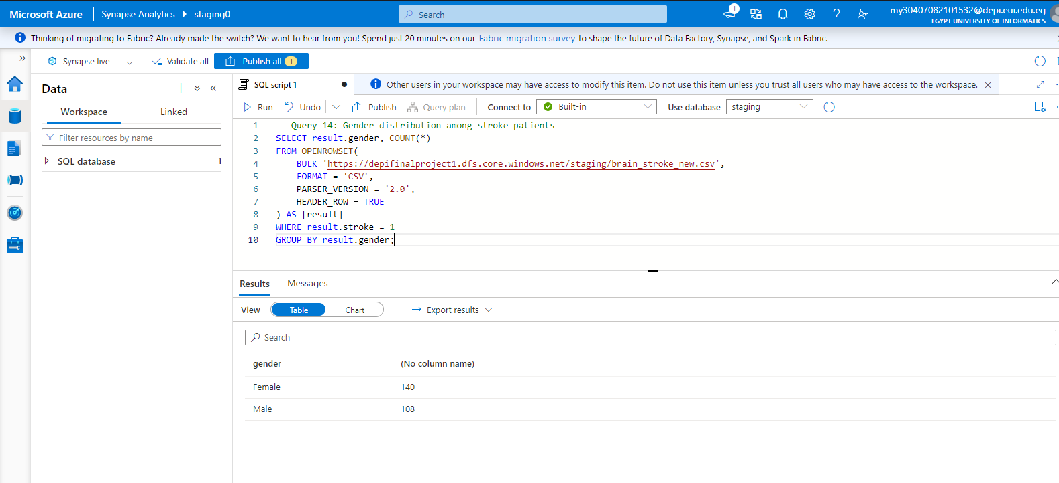
Queries on staging tables
This SQL query calculates the gender distribution among patients in the dataset. It uses OPENROWSET to access the data and to extract the ‘stroke' and ‘gender' fields from each row. The group by classifies data according to gender and then the count function counts the rows for each gender value.

Slide 35
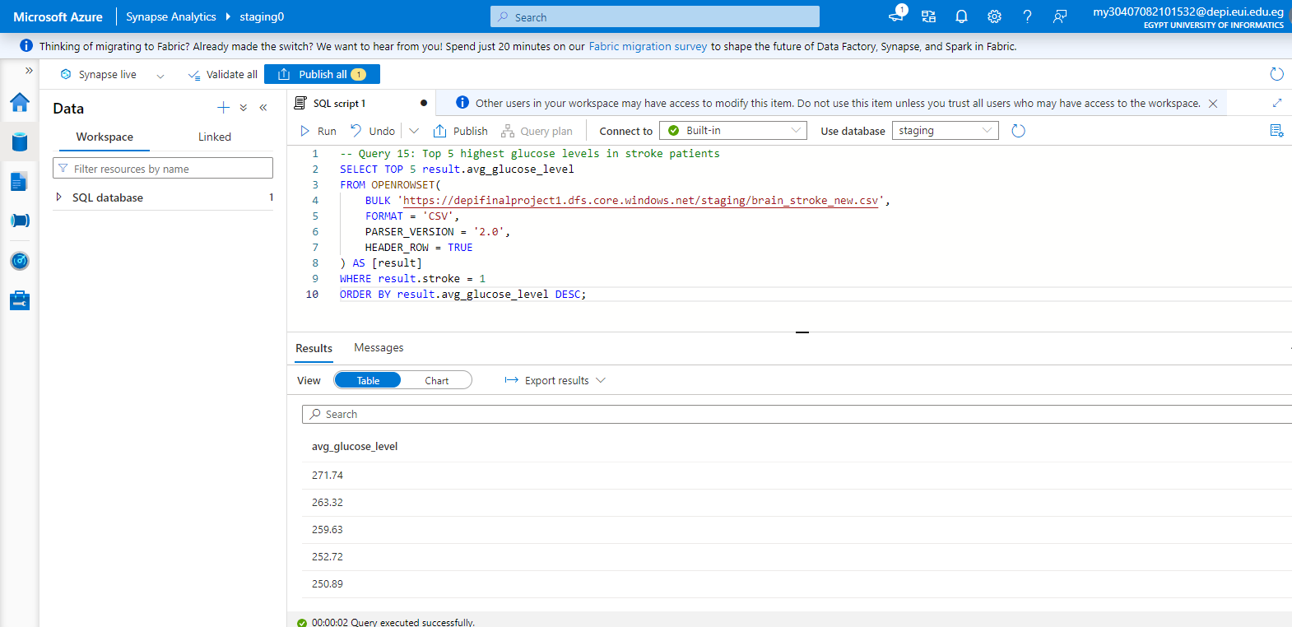
Queries on staging tables
This SQL query calculates the top 5 highest glucose levels in the dataset. It uses OPENROWSET to access the data source, and to extract the 'glucose' field from each row. The SELECT TOP 5 clause limits the result to the five highest values. The ORDER BY clause sorts the glucose levels in descending order (DESC), ensuring the highest values are returned.

Slide 36
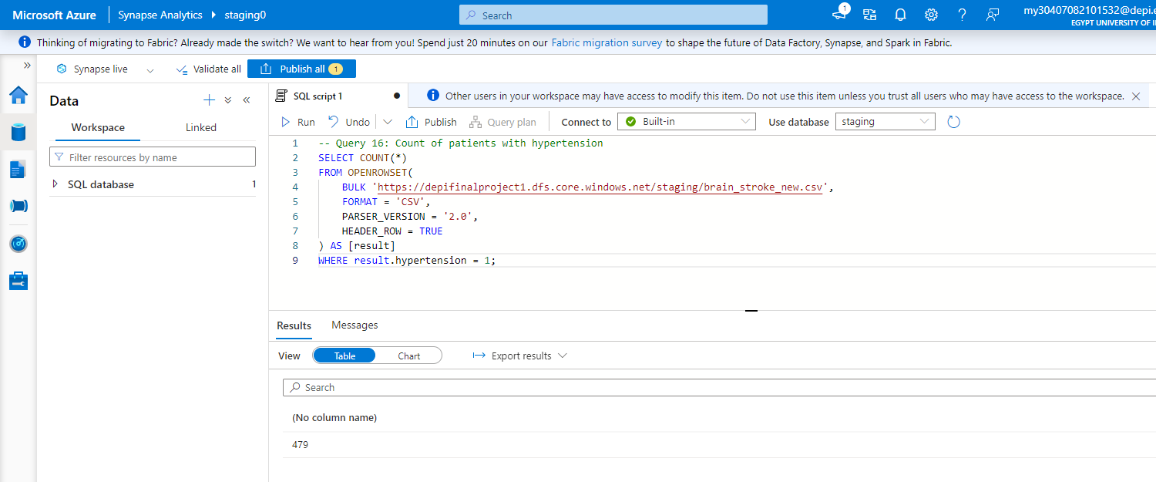
Queries on staging tables
This SQL query calculates the top 5 highest glucose levels in the dataset. It uses OPENROWSET to access the data source, and to extract the 'glucose' field from each row. The SELECT TOP 5 clause limits the result to the five highest values. The ORDER BY clause sorts the glucose levels in descending order (DESC), ensuring the highest values are returned.

Slide 37
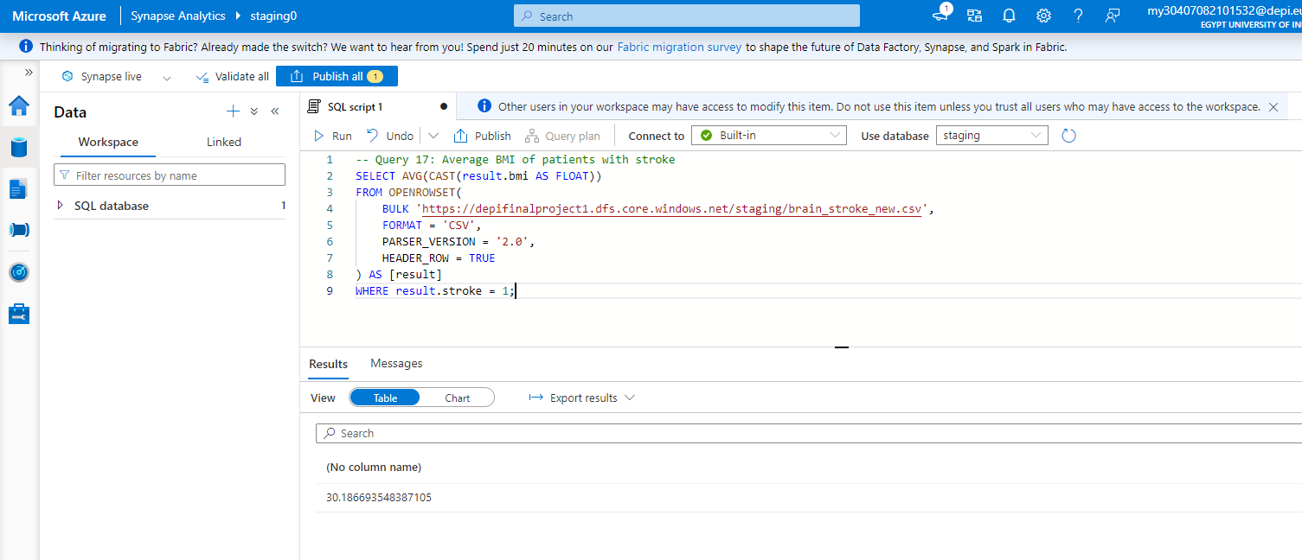
Queries on staging tables
This SQL query calculates the average BMI of patients with stroke in the dataset. It uses OPENROWSET to access the data source, and to extract the 'bmi' and 'stroke' fields from each row. The AVG function computes the mean BMI, but only for rows where the 'stroke' value equals 1 (indicating patients who have had a stroke).

Slide 38
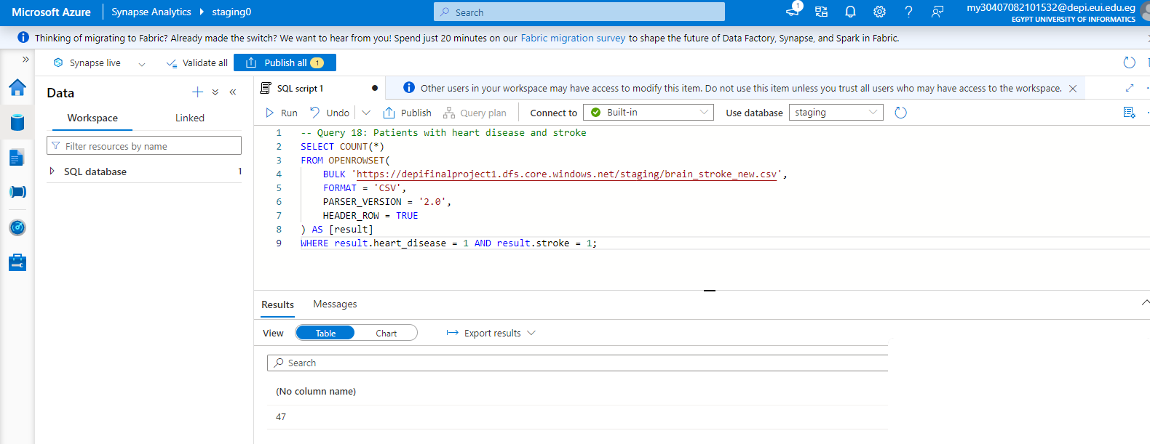
Queries on staging tables
This SQL query counts the number of patients who have both heart disease and stroke. It uses OPENROWSET to access the data source, and to extract the 'heart_disease' and 'stroke' fields from each row. The COUNT function tallies the rows where both 'heart_disease' and 'stroke' values equal 1, indicating patients who have both conditions.

Slide 39
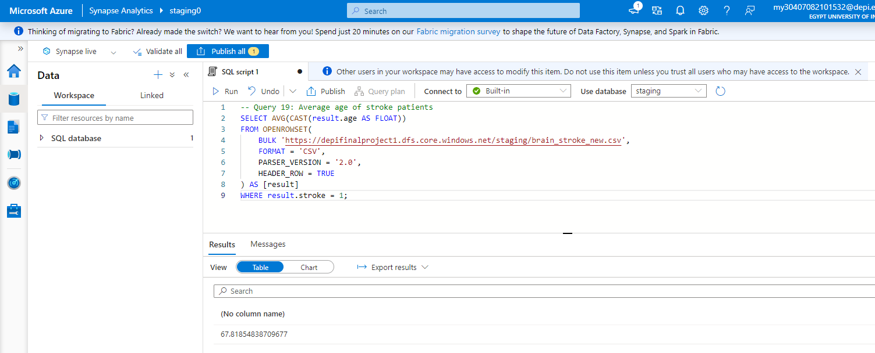
Queries on staging tables
This SQL query calculates the average age of stroke patients. It uses OPENROWSET to access the data source, and to extract the age’ field from each row. The avg calculates the average of the values extracted.

Slide 40
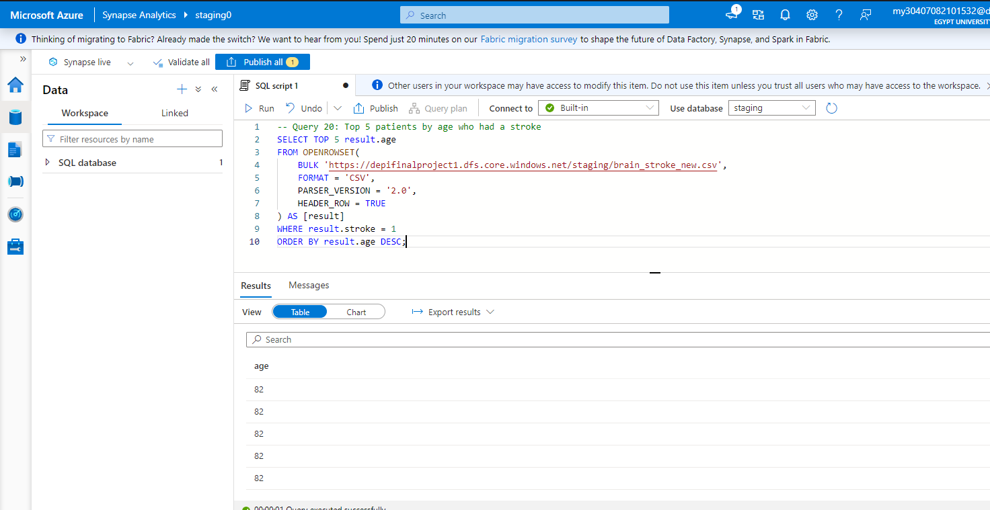
Queries on staging tables
This SQL query calculates the top 5 highest age values where the patient have a stroke in the dataset. It uses OPENROWSET to access the data source, and to extract the age and stroke field from each row. The SELECT TOP 5 clause limits the result to the five highest values. The ORDER BY clause sorts the age levels in descending order (DESC), ensuring the highest values are returned.

Slide 41

Queries on staging tables
This SQL query calculates the total rows. It uses OPENROWSET to access the data source, and to extract each row. The count function displays the number of rows returned.

Slide 42
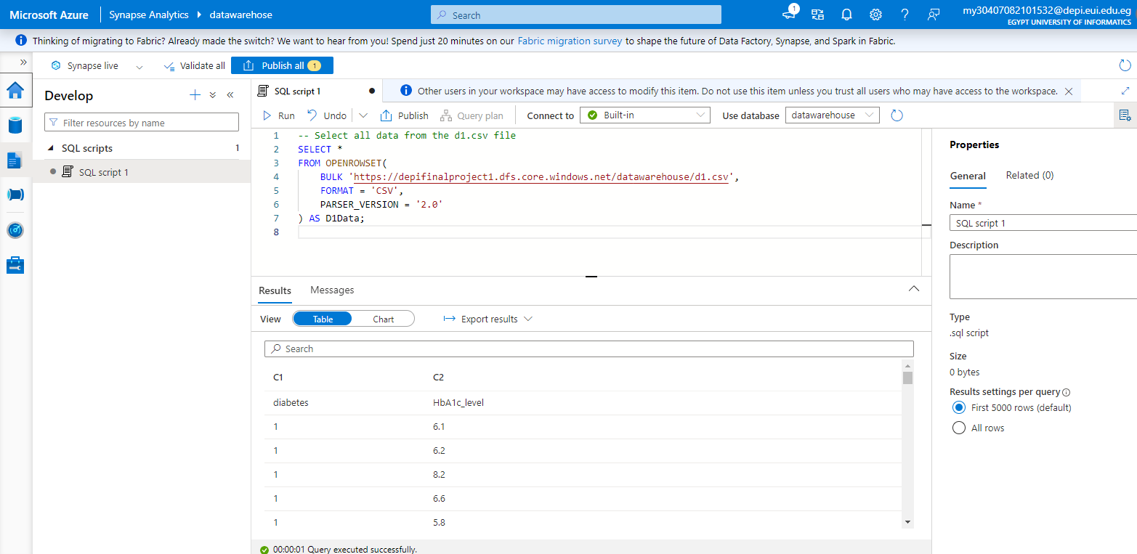
Queries on Datawarehouse Data
This SQL query calculates the total rows. It uses OPENROWSET to access the data source, and to extract each row. The count function displays the number of rows returned.

Slide 43
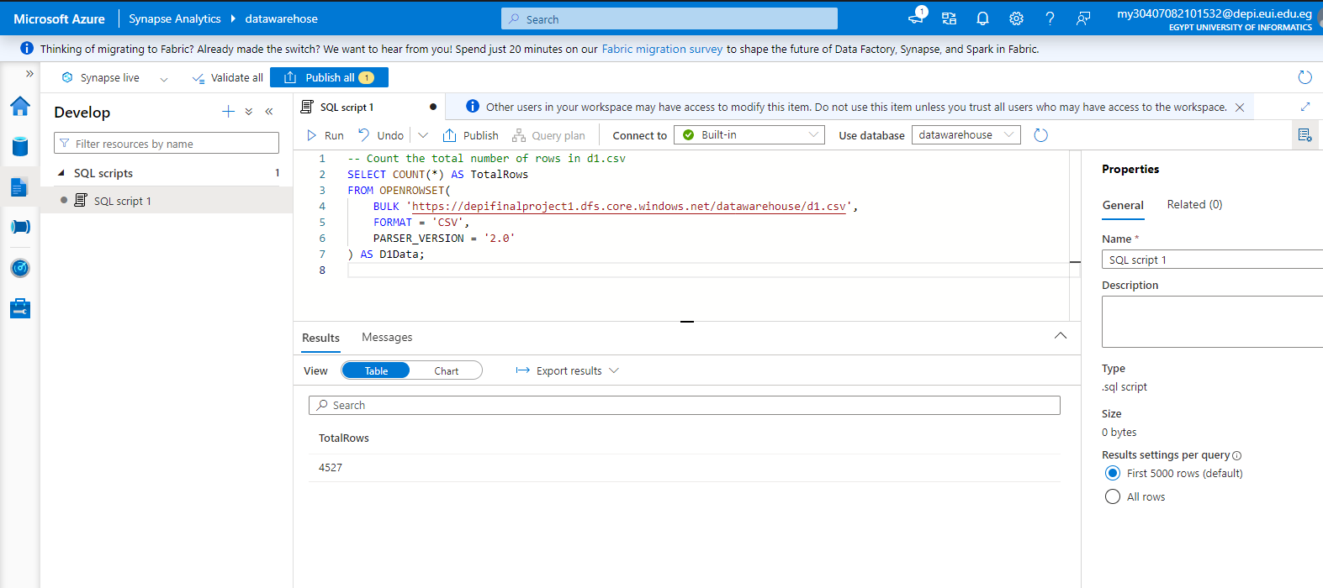
Queries on Datawarehouse Data
The SQL query in the image counts the total number of rows in a CSV file stored in Azure Blob Storage. It uses the `OPENROWSET` function to access the CSV file and returns the total row count, which is displayed as `TotalRows`. In this case, the result shows 4,527 rows.

Slide 44
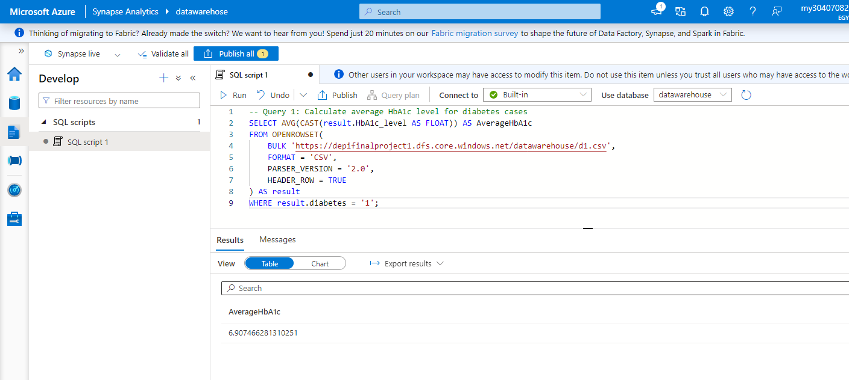
Queries on Datawarehouse Data
The SQL query in the image calculates the average HbA1c level for diabetes cases (where diabetes equals 1) from a CSV file stored in Azure Blob Storage. It uses the `OPENROWSET` function to load the data, selects the HbA1c values, and calculates the average. The result shows that the average HbA1c level for diabetes cases is approximately 6.97.

Slide 45
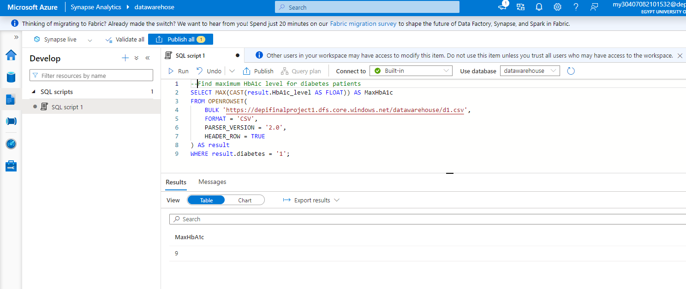
Queries on Datawarehouse Data
The SQL query in the image calculates the average HbA1c level for diabetes cases (where diabetes equals 1) from a CSV file stored in Azure Blob Storage. It uses the `OPENROWSET` function to load the data, selects the HbA1c values, and calculates the average. The result shows that the average HbA1c level for diabetes cases is approximately 6.97.

Slide 46
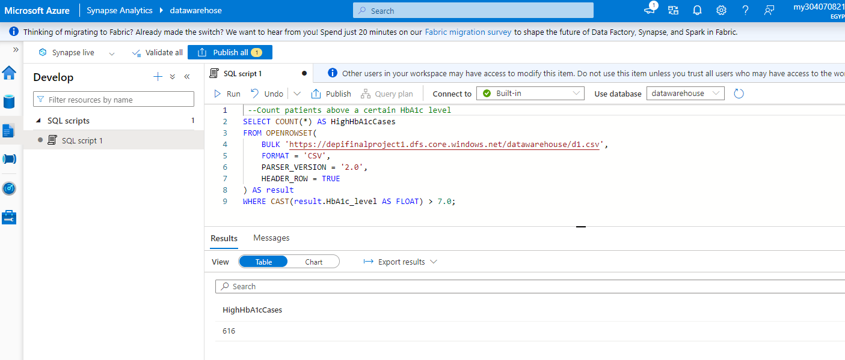
Queries on Datawarehouse Data
The SQL query in the image counts the number of patients with an HbA1c level greater than 7.8 from a CSV file stored in Azure Blob Storage. It uses the `OPENROWSET` function to load the data and filters the rows where the HbA1c level is above 7.8. The result shows that there are 616 such cases.

Slide 47
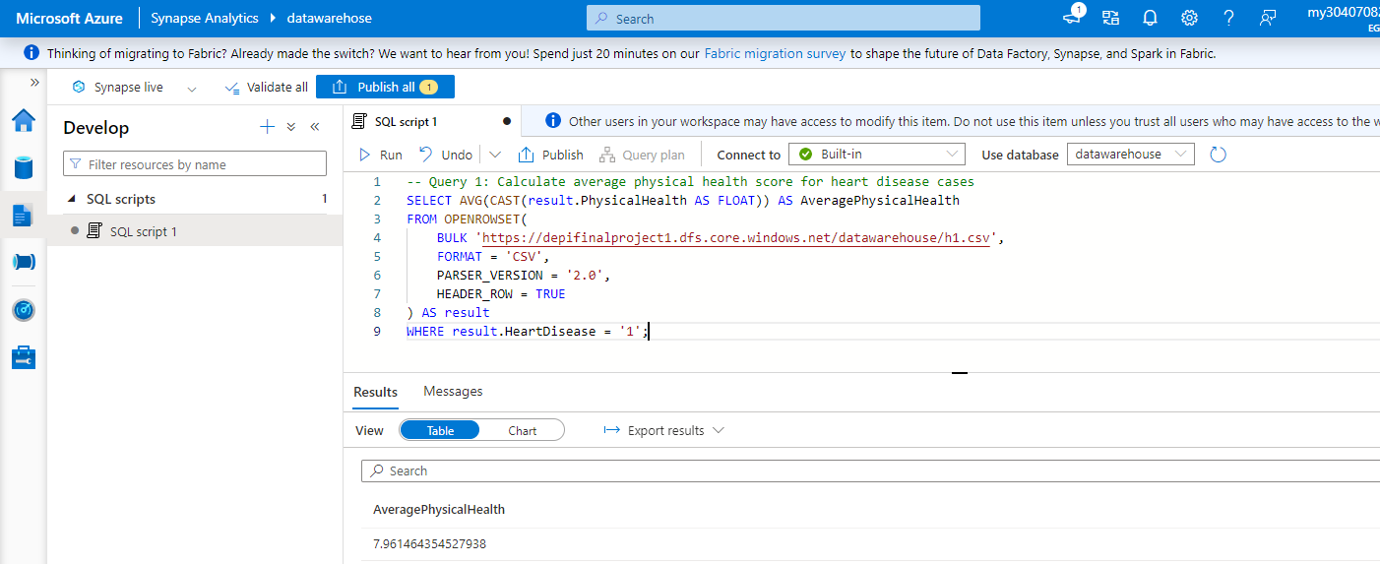
Queries on Datawarehouse Data
The SQL query in the image calculates the average physical health score for patients with heart disease (where heart disease equals 1) from a CSV file stored in Azure Blob Storage. It uses the `OPENROWSET` function to load the data, selects the physical health scores, and calculates the average. The result shows that the average physical health score for heart disease cases is approximately 7.96.

Slide 48
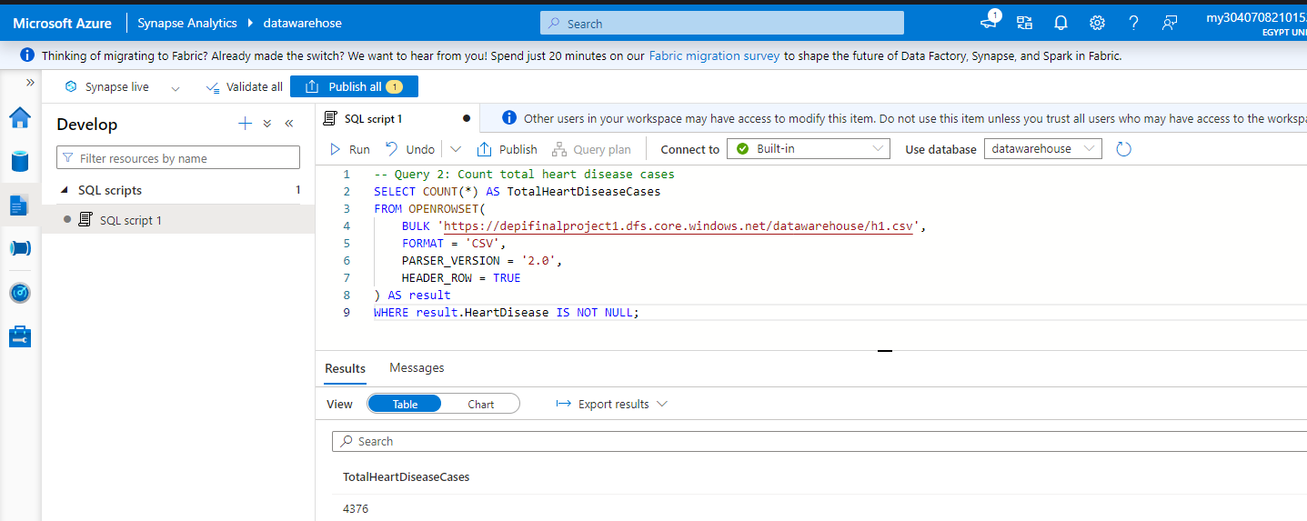
Queries on Datawarehouse Data
The SQL query in the image counts the total number of heart disease cases (where the heart disease field is not null) from a CSV file stored in Azure Blob Storage. It uses the `OPENROWSET` function to load the data and filters rows where the heart disease value is not null. The result shows that there are 4376 heart disease cases.

Slide 49
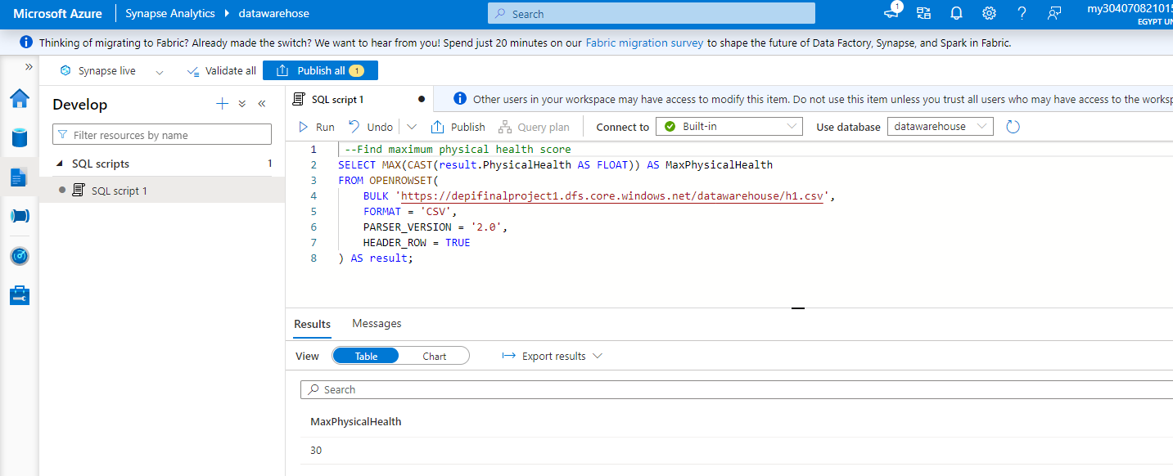
Queries on Datawarehouse Data
The SQL query in the image finds the maximum physical health score from a CSV file stored in Azure Blob Storage. It uses the `OPENROWSET` function to load the data and calculates the maximum value of the physical health score. The result shows that the maximum physical health score is 30.

Slide 50
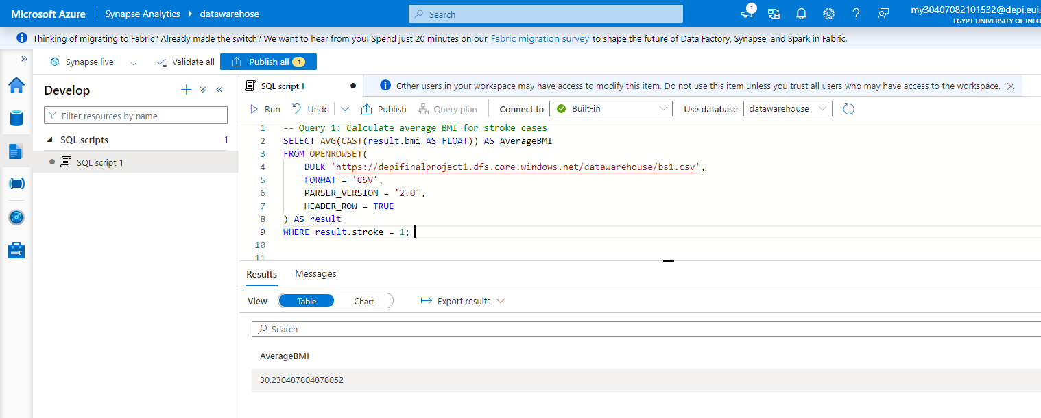
Queries on Datawarehouse Data
The SQL query in the image calculates the average BMI for patients who have had a stroke (where stroke equals 1) from a CSV file stored in Azure Blob Storage. It uses the `OPENROWSET` function to load the data and calculates the average BMI for these stroke patients. The result shows that the average BMI for stroke patients is approximately 30.23 .

Slide 51
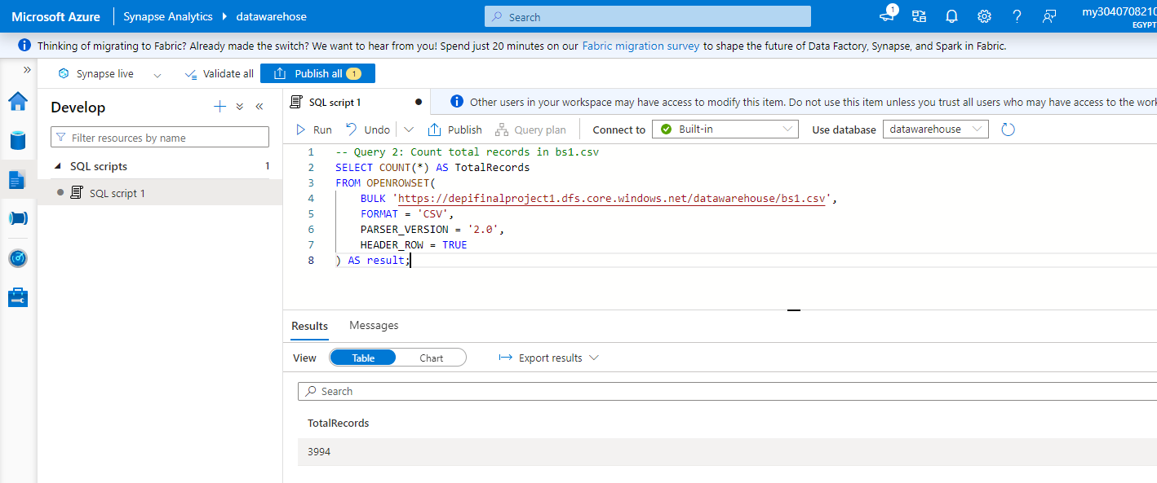
Queries on Datawarehouse Data
The SQL query in the image counts the total number of records in the file `bsl.csv` stored in Azure Blob Storage. It uses the `OPENROWSET` function to load the data and returns the total count of records. The result shows that there are 3,944 total records in the file.

Slide 52
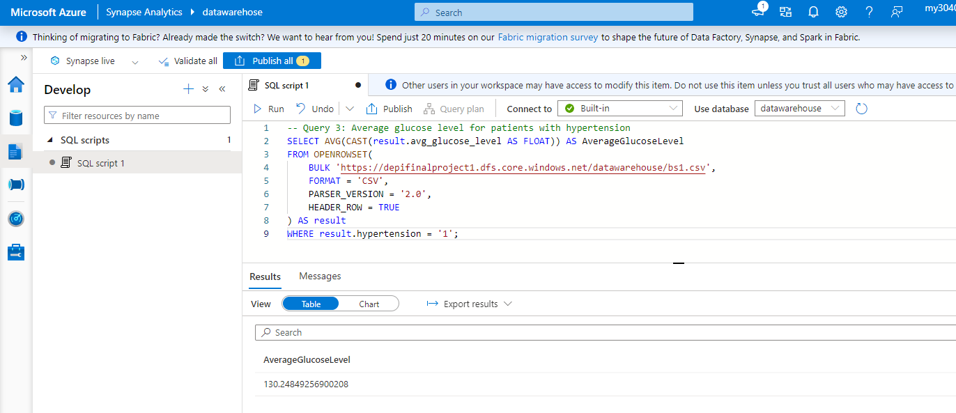
Queries on Datawarehouse Data
The SQL query in the image calculates the average glucose level for patients with hypertension (where hypertension equals 1) from a CSV file stored in Azure Blob Storage. It uses the `OPENROWSET` function to load the data and calculates the average glucose level for these patients. The result shows that the average glucose level for hypertension patients is approximately 130.24.

Slide 53

Queries on Datawarehouse Data
The SQL query in the image counts the number of patients who smoke (where smoking status equals 1) from a CSV file stored in Azure Blob Storage. It uses the `OPENROWSET` function to load the data and filters rows where the smoking status is marked as 1. The result shows that there are 0 patients who smoke.

Slide 54

Queries on Datawarehouse Data
The SQL query in the image finds the maximum age of stroke patients (where stroke equals 1) from a CSV file stored in Azure Blob Storage. It uses the `OPENROWSET` function to load the data and calculates the maximum age for stroke patients. The result shows that the maximum age of stroke patients is 82.

Slide 55

Queries on Datawarehouse Data
The SQL query in the image calculates the average age of people who have had a stroke (where stroke equals 1) from a CSV file stored in Azure Blob Storage. It uses the `OPENROWSET` function to load the data and calculates the average age for stroke patients. The result shows that the average age of people with a stroke is approximately 68.03 years.

Slide 56

Queries on Datawarehouse Data
The SQL query in the image calculates the average BMI of people with hypertension (where hypertension equals 1) from a CSV file stored in Azure Blob Storage. It uses the `OPENROWSET` function to load the data and calculates the average BMI for these patients. The result shows that the average BMI of people with hypertension is approximately 31.86.

Slide 57

Queries on Datawarehouse Data
The SQL query in the image counts the number of people with heart disease (where heart disease equals 1) from a CSV file stored in Azure Blob Storage. It uses the `OPENROWSET` function to load the data and returns the total count of people with heart disease. The result shows that there are 1,830 people with heart disease.

Slide 58

Queries on Datawarehouse Data
The SQL query in the image calculates the average glucose level of people with diabetes (where diabetes equals 1) from a CSV file stored in Azure Blob Storage. It uses the `OPENROWSET` function to load the data and calculates the average glucose level for these patients. The result shows that the average glucose level for people with diabetes is approximately 109.64.

Slide 59

Queries on Datawarehouse Data
The SQL query in the image counts the number of people who have both kidney disease (where kidney disease equals "Yes") and have had a stroke (where stroke equals 1) from a CSV file stored in Azure Blob Storage. It uses the `OPENROWSET` function to load the data and filters rows that meet both conditions. The result shows that there are 14 people with both kidney disease and a history of stroke.

Slide 60

Queries on Datawarehouse Data
The SQL query in the image calculates the average HbA1c level of people with diabetes (where diabetes equals 1) from a CSV file stored in Azure Blob Storage. It uses the `OPENROWSET` function to load the data and calculates the average HbA1c level for these patients. The result shows that the average HbA1c level for people with diabetes is approximately 6.9 .

Slide 61

Queries on Datawarehouse Data
The SQL query in the image calculates the average age of people who have had a heart stroke (where heart stroke equals "Yes") from a CSV file stored in Azure Blob Storage. It uses the `OPENROWSET` function to load the data and calculates the average age for these patients. The result shows that the average age of people with a heart stroke is approximately 56.43 years.

Slide 62

Queries on Datawarehouse Data
The SQL query in the image counts the number of smokers (where smoking status is not equal to 0) from a CSV file stored in Azure Blob Storage. It uses the `OPENROWSET` function to load the data and filters the rows where the smoking status is not 0. The result shows that there are 3206 smokers.

Slide 63

Queries on Datawarehouse Data
The SQL query in the image calculates the average BMI of people with kidney disease (where kidney disease equals "Yes") from a CSV file stored in Azure Blob Storage. It uses the `OPENROWSET` function to load the data and calculates the average BMI for these patients. The result shows that the average BMI of people with kidney disease is approximately 30.8.

Slide 64

Queries on Datawarehouse Data
The SQL query in the image counts the number of people with difficulty walking (where difficulty walking equals "Yes") from a CSV file stored in Azure Blob Storage. It uses the `OPENROWSET` function to load the data and filters the rows where difficulty walking is marked as "Yes." The result shows that there are 819 people with difficulty walking.

Slide 65
Queries on Datawarehouse Data
The SQL query in the image selects the top 5 patients by age who have had a stroke (where stroke equals 1) from a CSV file stored in Azure Blob Storage. It uses the `OPENROWSET` function to load the data and sorts the results by age in descending order. The result shows the top 5 stroke patients, all aged 82.

